Slide 1
Network : Cellular
Jae Hyeon Kim

Slide 2
Reference
William Stalling, Data and Computer Communications 10/E, Prentice Hall

Slide 3
Cellular Wireless Networks
Developed to increase the capacity available for mobile radio telephone service
Key technology for mobiles, wireless networks etc.
Based on the use of multiple low power transmitters
Area divided into cells
In a tiling pattern to provide full coverage
Each with own antenna, along with own range of frequencies
Served by base station : consisting of transmitter, receiver, and control unit
Adjacent cells re assigned different frequencies to avoid crosstalk : cells sufficiently distant can use same frequency band

Slide 4
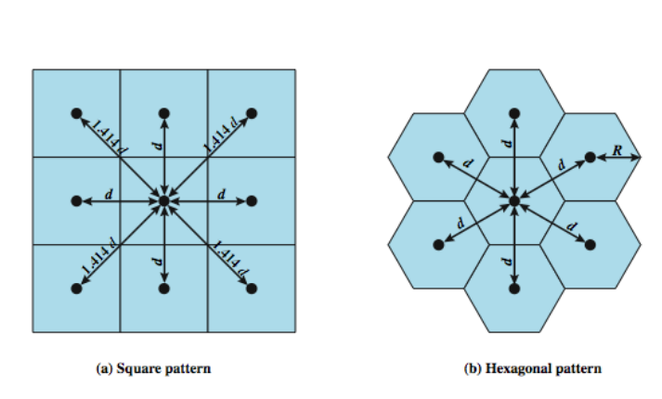
Cellular Geometries

Slide 5
Frequency Reuse (1)
Object is to share nearby (but not adjacent) cell frequencies without interfering with each other
Allows multiple simultaneous conversations with the same frequency, at the different areas
10 to 50 channels per cell
Power of base transceiver controlled
Allow communications within cell using a given frequency
Limit escaping power to adjacent cells

Slide 6
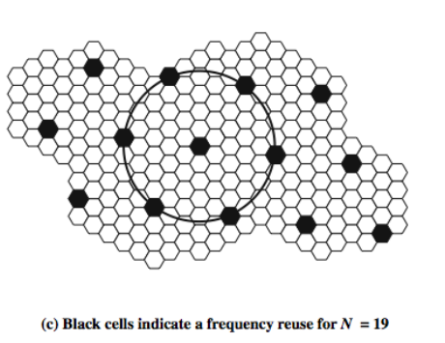
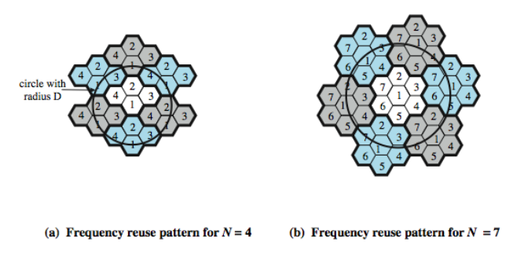
Frequency Reuse (2)

Slide 7
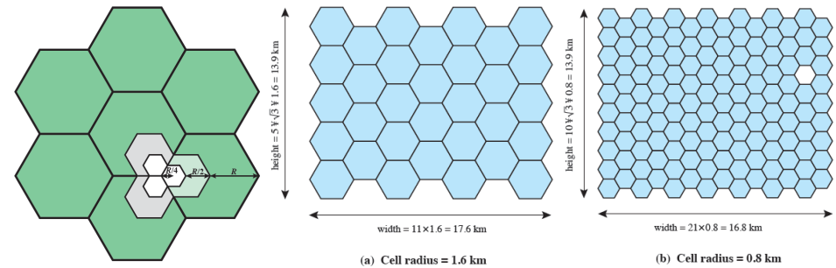
Increasing Capacity (1)
Add new channels
Not all channels used to start with
Frequency borrowing
Taken from adjacent cells by congested cells
Cell splitting
Use smaller cells in high use areas

Slide 8
Increasing Capacity (2)
Cell sectoring with directional antennas
Cell divided into wedge shaped sectors (3-6 per cell)
Each sector is assigned a separate subset of the cell’s channels
Directional antennas are used to focus on each sector
Microcells
As cells become smaller, antennas move from tops of hills and large buildings to tops of small buildings and sides of large buildings
Use reduced power to cover a much smaller area
Good for city streets in congested areas, along highways, inside large public buildings

Slide 9
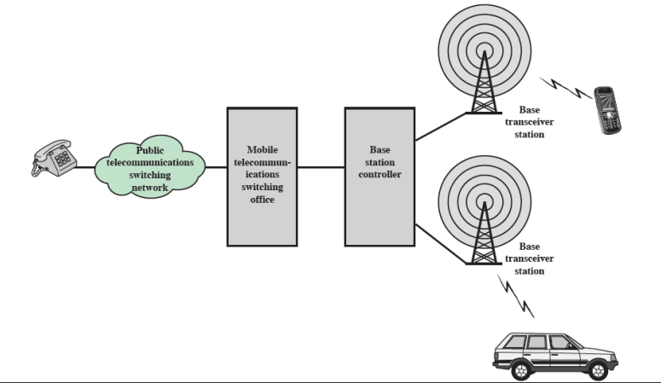
Cellular System
Cellular system channels between mobile and base station
Control channels : set up and maintain calls
Traffic channels : carry voice and data

Slide 10
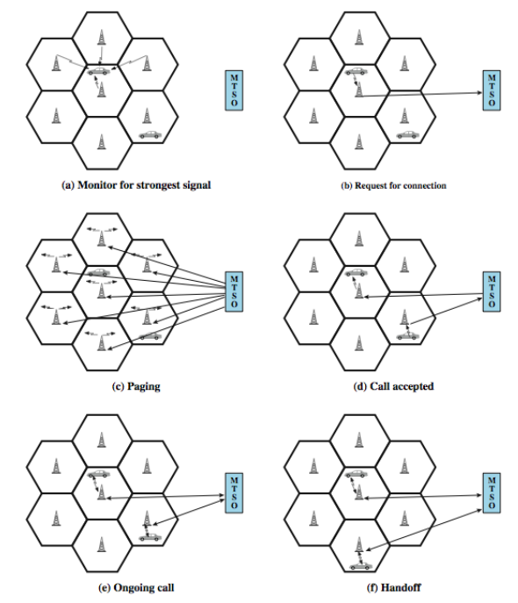
Example of Cellular Call

Slide 11
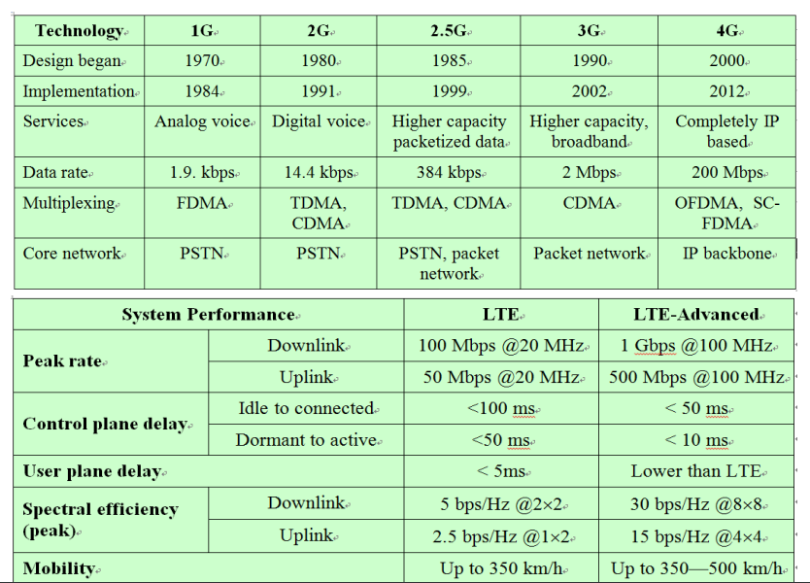
Cellular Network Generations

